Slide 1
COMP 2310 Data Structures and Algorithms
Lecture 2
Algorithm Complexity

Slide 2
Mathematical Reminders
Exponents, Summations, Logarithms
Complexity Classes

Slide 3

Common Functions: Exponents
$$Polynomials: \\ f(x)=a_{0}+a_{1}x+a_{2}x^{2}+…+a_{n}x^{n} \\ Exponentials: \\ a^{0}=1 \\ a^{1}=a \\ a^{−1}=1/a, \\ (a^{m})^{n}=a^{mn} \\ a^{m}a^{n}=a^{m+n}$$
Notes:
3

Slide 4

Summations
$$\sum_{i=1}^{n}{ca_{i}=}c\sum_{i=1}^{n}{a_{i}} \\ \sum_{i=1}^{n}{(a_{i}+b_{i})=}\sum_{i=1}^{n}{a_{i}}+\sum_{i=1}^{n}{b_{i}} \\ \sum_{i=1}^{n}{i}=1+2+...+n=\frac{n(n+1)}{2}=Θ(n^{2}) \\ \sum_{i=1}^{n}{i^{k}}=Θ(n^{k+1}) ...$$

Slide 5
Floor and Ceiling Functions
Let x be a real number.
The floor of x, denoted by ⌊x⌋, is defined as the greatest integer less than or equal to x.
The ceiling of x, denoted by ⌈x⌉, is defined as the least integer greater than or equal to x.
For x an integer, ⌊x⌋ = ⌈x⌉ = x
Examples:
⌊5.4⌋ = 5, ⌊−6.4⌋ = −7,
⌈5.4⌉ = 6, and ⌈−6.4⌉ = −6

Slide 6
Common Functions: Logarithms
The logarithm of a number to a given base is the power to which the base must be raised in order to produce that number.
We know that 10³ =1000, what is 3 here?
Similarly, since 2⁶ = 64, log₂64 = 6
Notes:
6

Slide 7
Common Functions: Logarithms
Three particular values for the base b are most common:
The natural logarithm (ln): Base b = e = 2.71828…
The common logarithm (log): Base b =10
The binary logarithm (lg or log) : Base b = 2
In computer applications we use log base 2.
So, log 32 means log₂ 32
Notes:
7

Slide 8

Common Functions: Logarithms
To find the logarithm of a number with a given base we solve the following equation
Examples:
$$b^{x}=a$$
Notes:
What is log 1000 for base 10?
What is log 16 for base 2?
8

Slide 9
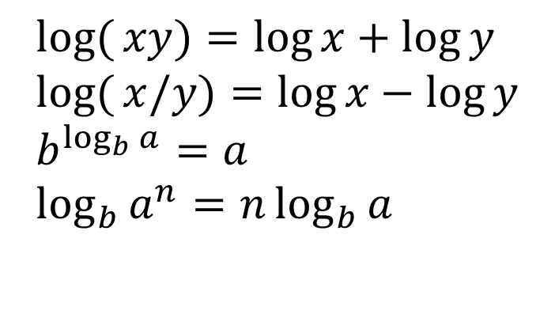
Common Functions: Logarithms
Some useful expressions:
$$\log{(}xy)=\log{x}+\log{y} \\ \log{(}x/y)=\log{x}−\log{y} \\ b^{\log_{b}{a}}=a \\ \log_{b}{a^{n}}=n\log_{b}{a}$$
log_{b}(1) = 0
log_{b}(b) = 1
Notes:
9

Slide 10
Algorithm Complexity

Slide 11
Algorithm Complexity
Algorithms differ in efficiency.
The difficulty of algorithms for comparing their efficiencies is called computational complexity.
Computational complexity indicates how much effort is required for an algorithm or how costly it is.
An algorithm is hardly of any use if
very long time
large main memory
Notes:
Algorithms developed to solve a certain problem difffer in efficiency.
The difficulty of algorithms for comparing their efficiencies is called computational complexity.
Computational complexity indicates how much effort is required for an algorithm or how costly it is.
An algorithm that solves a problem in a very long time is hardly of any use.
An algorithm that requires extremely large main memory is also not useful in most computers.

Slide 12
How to Measure Complexity ?
The cost of an algorithm can be measured via:
Time (CPU usage)
Space (Memory and disk usage)
Network usage
The time factor is generally more important than the others.
Notes:
Is it possible to measure the cost and complexity of an algorithm?
The cost of an algorithm can be measured in a number of ways:
Time (CPU usage)
Space (Memory and disk usage)
Network usage
The time factor is generally more important than the others.
→Efficiency considerations are usually focused on time factor.
12

Slide 13
Time Factor - How to measure time cost of an algorithm?
Can we use physical run time as a criterion?
No. Because run time is always system dependent
To make a meaningful comparison, all algorithms must run on the same machine.
Run time of an algorithm also depends on the operating system and language used to implement it.
Physical run time is not a good measure of complexity.
Notes:
How to measure time cost of an algorithm?
Can we use physical run time as a criterion?
No. Because run time is always system dependent:
An inefficient algorithm run on a super computer can execute much faster than an efficient algorithm run on a PC.
To make a meaningful comparison, all algorithms must run on the same machine.
Run time of an algorithm also depends on the operating system and language used to implement it.
→ Physical run time is not a good mesure of complexity
13

Slide 14
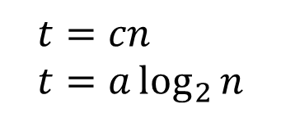
Finding a Complexity Measure
We do not use real-time units such as micro seconds.
We use logical units instead of real-time units.
We need a functional relationship between the size of an object (array, file…) and a logical time measure for the algorithm.
Examples: Assume n is the size. Relationships between execution time t and n may be:
t = an³+bn²+…. ……………………….
where a, b and c are some constants.
$$t=cn \\ t=a\log_{2}{n}$$
Notes:
14

Slide 15
Finding a Complexity Measure
How to determine a good functional relationship?
A function expressing the relationship between t and n usually is not in a simple form, but :
Finding such a function is important only for large data sizes.
We can usually ignore some of the terms that do not substantially change the function’s magnitude.
The resulting function is simple and an approximation of the original function.
For very large n, this approximation is satisfactory.
The simplified measure of efficiency is called asymptotic complexity of the algorithm.
Notes:
15

Slide 16
Growth of Functions: Most Influential Term
Example: Growth of a function
n | n² | 10n | 100 | f(n) | Contribution to f(n) by n²
1
10
100
1000

Slide 17
Growth of Functions: Most Influential Term
Example: Growth of a function
n | n² | 10n | 100 | f(n) | Contribution f(n) by n²
1 | 1 | 10 | 100 | 111 | % 0.9
10 | 100 | 100 | 100 | 300 | %33.3
100 | 10,000 | 1000 | 100 | 11,100 | %90.1
1000 | 1,000,000 | 10,000 | 100 | 1,010,100 | %99.0
Most influential term in f(n) is n²

Slide 18
Simplified Expression: Big-O notation
We need a simplified expression to represent the growth of a function.
Definition: Big-O
f(n) = O(g(n))
if there exists a positive integer n₀ and a positive constant c, such that
f(n) ≤ c.g(n) ∀ n ≥ n₀
Note that, since there are 2 unknowns, the solution will not be unique.
Many different pairs of n and c will satisfy the inequality.
Notes:
18

Slide 19
Simplified Expression: Big-O notation
Example:
Show that f(n)=3n+8 is O(n)
We need to show that 3n+8 <= cn
→(c-3)n >= 8 , Take c=4
→ n>= 8, so we have a solution for c=4 and n₀=8
Notes:
19

Slide 20
Big O : Example-1 How to Define c?
f(n) = 2n + 5 g(n) = n
Consider the condition 2n + 5 <= n will this condition ever hold? No!
How about if we stick a constant to n? 2n + 5 <= 3n the condition holds for values of n greater than or equal to 5
This means we can select c = 3 and n₀ = 5

Slide 21
Example-1 : Illustration
3n
2n+5
2n+5
n
n₀=5
point where 3n “beats” 2n+5
2n+5 is O( n )
Notes:
https://stackoverflow.com/questions/64390621/explanation-for-asymptotic-notation-graph

Slide 22
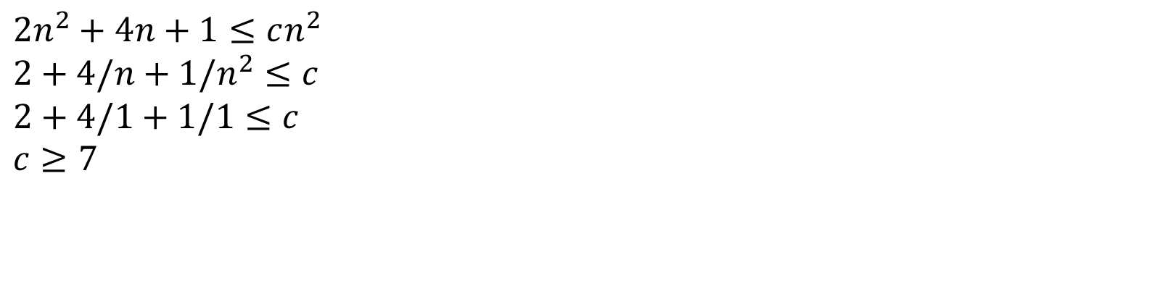
Big-O notation : Example2
Show that, 2n²+4n+1 is O(n²)
We need to show that the condition
is satisfied for some c and n. For example, take n=1. We have
$$2n^{2}+4n+1≤cn^{2} \\ 2+4/n+1/n^{2}≤c \\ 2+4/1+1/1≤c \\ c≥7$$
This is not a unique solution. The values for n and c satisfy the inequality in the definition. But many many different pairs will also satisfy the inequality.
Notes:
22

Slide 23
Big-O notation: Illustration-2
cg(n)=7n²
n=1 n=2…
n
Notes:
23

Slide 24
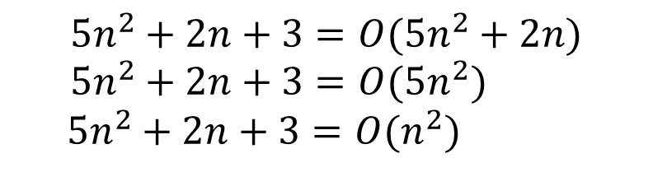
Simplifying Big-O Notation
We usually need to use the simplest formula in the Big-O notation.
We write
The following expressions are all correct but we use the final form:
$$5n^{2}+2n+3=O(5n^{2}+2n) \\ 5n^{2}+2n+3=O(5n^{2})$$
$5n^{2}+2n+3=O(n^{2})$
Notes:
24

Slide 25
Simplifying Big-O Notation
Examples:
$$f(n)=3n\log{n}−2=O(n\lg{(}n))$$
Notes:
25

Slide 26
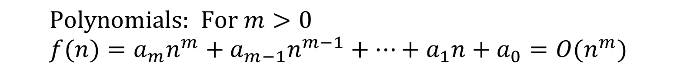
Asymptotic Bounds for Polinomials
$$\text{Polynomials}\text{: }\text{For} m>0 \\ f(n)=a_{m}n^{m}+a_{m−1}n^{m−1}+⋯+a_{1}n+a_{0}=O(n^{m})$$
The highest exponent determines the complexity class.
Example :
f(n) = 15n² + 199n + 12000
= O(n²)
Notes:
26

Slide 27
Determining Asymptotic Complexity
f(n) should represent runtime of an algorithm closely. How to determine it?
We have to count the number of basic operations such as assignments, arithmetic operations when their numbers grow.
Example 1: Consider the code fragment to calculate
T=
int sum3(int n)
{ int sum;
sum=0;
for(int i=1,i<=n, i++)
sum +=i*i*i;
return sum;
}
Notes:
27

Slide 28
Determining Asymptotic Complexity
How many basic operations should be performed?
Ignore declarations. no. of opns
int sum3(int n) .......... 0
{ .......... 0
int sum; .......... 0
1 sum=0; .......... 1
2 for(int i=1,i<=n ,i++) ... 2n+2
3 sum +=i*i*i; ........ 4n
4 return sum; .......... 1
} ......... 0
Total # of operations: ..... 6n+4
(1 for initialize, n+1 for the tests, n for the increments)
(four operations that are executed: +=**)
Notes:
28

Slide 29
Determining Asymptotic Complexity
Example Explained:
We assume that declarations need no time.
Line 1: Counts 1.
Line 2: Initializing i counts 1,
testing for i<=n counts n+1,
incrementing i counts n.
Line 3: Two multiplication counts 2n,
one addition couns n,
one assignment counts n,
Line 4: Counts 1.
Total : f(n)= 6n+4 which is O(n).
Notes:
29

Slide 30
General Rules
Rule 1:
Running time of “for” loops = Running times of the statements inside the loop x the number of iterations
Example :
for (i=0; i<n; i++)
k++;
The code is
Notes:
30

Slide 31
General Rules
Rule 2:
Running time of nested loops =The running time of the statements inside the loop x The product of the sizes of all the loops.
Example :
for (i=0; i<n,i++)
for(j=1,j<=n,j++)
k++;
The code is
Note that we ignore non influential terms and even coefficients in actual f(n)
Notes:
31

Slide 32
Finding Asymptotic Complexity
More than one loops :
for (i=0; i<n; i++) O(n)
a[i]=0;
for (i=0; i<n; i++)
for (j=0; j<n; j++) O(n²)
a[i]+=a[j]+i+j;
Asymptotic complexity:
O(n) + O(n²) = O(n²)
Notes:
32

Slide 33
General Rules
Rule 3:
Running time of control statements = The running time of the statements of the test + maximum of the running times of the conditions
Rule 4:
Time complexity of a function call (or set of statements) is considered as O(1) if it doesn’t contain loop, recursion and call to any other non-constant time function.
Example : a = ARR[5];
Complexity is independent of the input size.
Notes:
33

Slide 34
General Rules
Rule 5: O(logn)
Time Complexity of a loop is considered as O(logn) if the loop variables is divided(/) or multiplied(*) by a constant amount.
Example: How many times (k) the loop will be executed? n=32;
k=0;
for(i=n, i>1, i=i/2) // Example : i=32,16,8,4,2,1.
k++; // k = 5 = log₂ 32
…………………………………………………………………. k=0;
for(i=1, i<n, i=i*2) // i=1,2,4,8,16,32, k=5
k++;

Slide 35
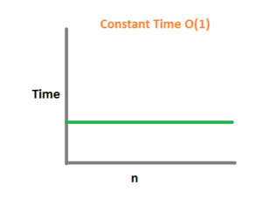
Constant Time
Constant time implies that the number of operations the algorithm needs to perform to complete a given task is independent of the input size.
Examples :
Accessing a single element of an array.
Given a list, report the first element

Slide 36
Worst Case – Best Case - Average Case
Worst case Running Time: The behavior of the algorithm with respect to the worst possible case of the input instance
An upper bound on the running time for any input. Knowing it gives us a guarantee that the algorithm will never take any longer
Best case Running Time: The input of size n for which the algorithm runs the shortest among all possible inputs of same size. Lower bound on running time of an algorithm. Not very informative!
Average case Running Time: An estimate of the running time for an "average" input. It is assumed that all inputs of a given size are equally likely.
The average case analysis is not easy to do in most practical cases and it is rarely done.
→In general, we perform worst case analysis .
Notes:
36

Slide 37
Worst Case – Best Case - Average Case
Time
Typically algorithms complexities are measured by their worst case

Slide 38
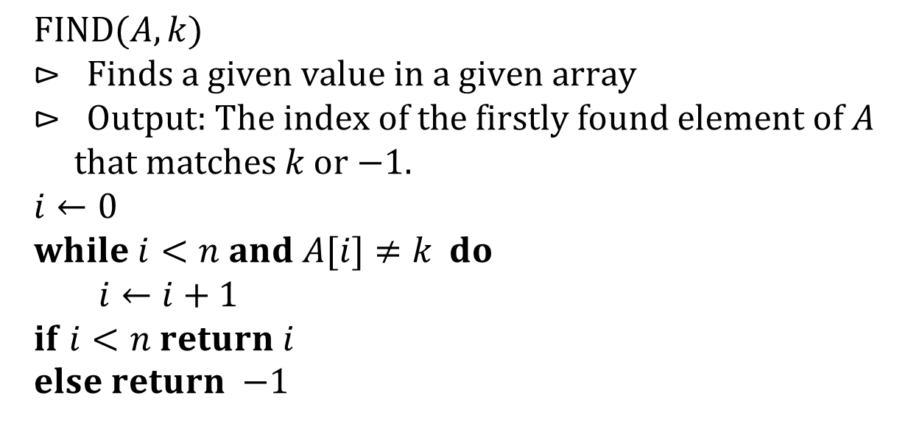
Worst Case – Best Case - Average Case
Consider the following algorithm for finding the position of a given value in an array:
What are the best, worst and average case complexities?
$$\text{FIND}(A,k) \\ ⊳ \text{Finds} \text{a} \text{given} \text{value} \text{in} \text{a} \text{given} \text{array} \\ ⊳ \text{Output}\text{: }\text{The} \text{index} \text{of} \text{the} \text{firstly} \text{found} \text{element} \text{of} A \\ \text{that} \text{matches} k \text{or}\text{ −1.} \\ i←0 \\ while i<n and A[i]≠k do \\ i←i+1 \\ if i<n return i \\ else return\text{ −1}$$
Notes:
38

Slide 39
Worst Case – Best Case - Average Case
We have three questions about runtime of Find():
1. How long will it take in the best case?
In the best case, the target value is the first element of the array.
So the search takes O(1)
2. How long will it take in the worst case?
In the worst case, the value is the last element of the array or it is not in the array.
So the search takes time proportional to the length of the array: O(n).
3. How long will it take in the average case?
Any position in the array is equally likely.
So the expected value of the position will be (n/2) = O(n)

Slide 40

Big-O notation: Reminder
g(n)=7n²
$$f(n)=2n^{2}+4n+1$$
We represent actual complexity function f(n) by a simpler g(n) and say that f(n) is O ( n²).
n=1 n=2…
n
Notes:
40

Slide 41
Complexity Order of Common Functions
Constant<Logarithmic<linear<linear*log<quadratic<cubic<….<exponential
O(1) < O(logn) < O(n) < O(nlogn) < O(n²) < O(n³) < ….. < O( c^{n} ), (c>1)
Polinomial time algorithms:
O(n^{k}) , k>= 1
Exponential time algorithms :
O( c^{n}) , n represents power.

Slide 42
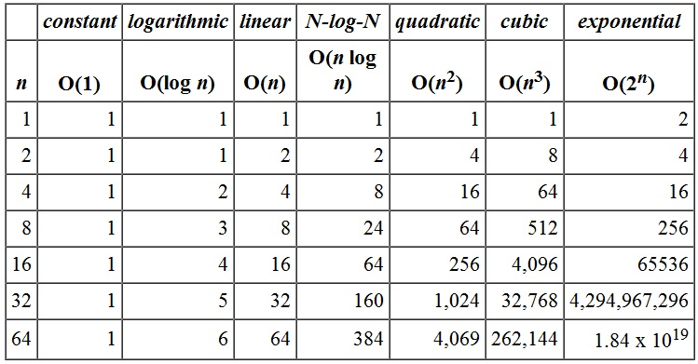
Growth of Complexity Functions

Slide 43
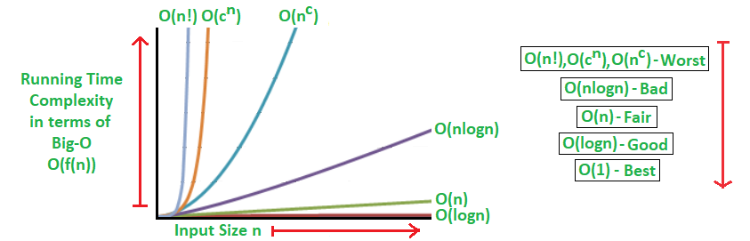
Complexity functions : n is the input size and c is a positive constant.

Slide 44
Running Times
Assume N = 100,000 and processor speed is 1,000,000,000 operations/sec
Times needed for various complexity functions:
Function | Running Time
2^{N} | 3.2 x 10^{30,086} years
N⁴ | 3171 years
N³ | 11.6 days
N² | 10 seconds
N N | 0.032 seconds
N log N | 0.0017 seconds
N | 0.0001 seconds
N | 3.2 x 10⁻⁷ seconds
log N | 1.2 x 10⁻⁸ seconds

Slide 45
Common Time Complexities
BETTER
WORSE
O(1) constant time
O(log n) log time
O(n) linear time
O(n log n) log linear time
O(n²) quadratic time
O(n³) cubic time
O(n^{k}) polynomial time
O(2^{n}) exponential time
O(n!) “
…….

Slide 46
Exponential Time?
What is the implication of exponential time?
Estimated age of the Universe (From Big-Bang !)
~ 14 billion years
= 14*10⁹ years
~ 10 ¹⁷ seconds
~ 10 ²³ microseconds
An exponential time problem of moderate size, for example n = 100 would require more time than the age of the universe!
→ Computers are helpless to find exact solutions to most exponential time problems!

